Slide 1

SQL Injection
19CSE335 Ethical Hacking

Slide 2
SQL Injection
Injection attacks aim at
bypassing authentication
manipulating data
viewing sensitive data
executing commands on the remote host
The classic example of an injection attack is SQL injection

Slide 3
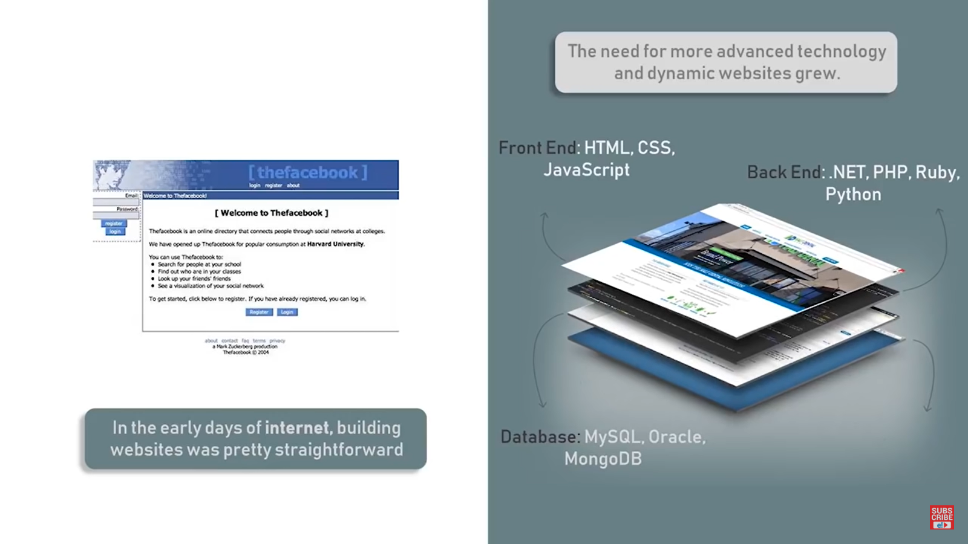

Slide 4

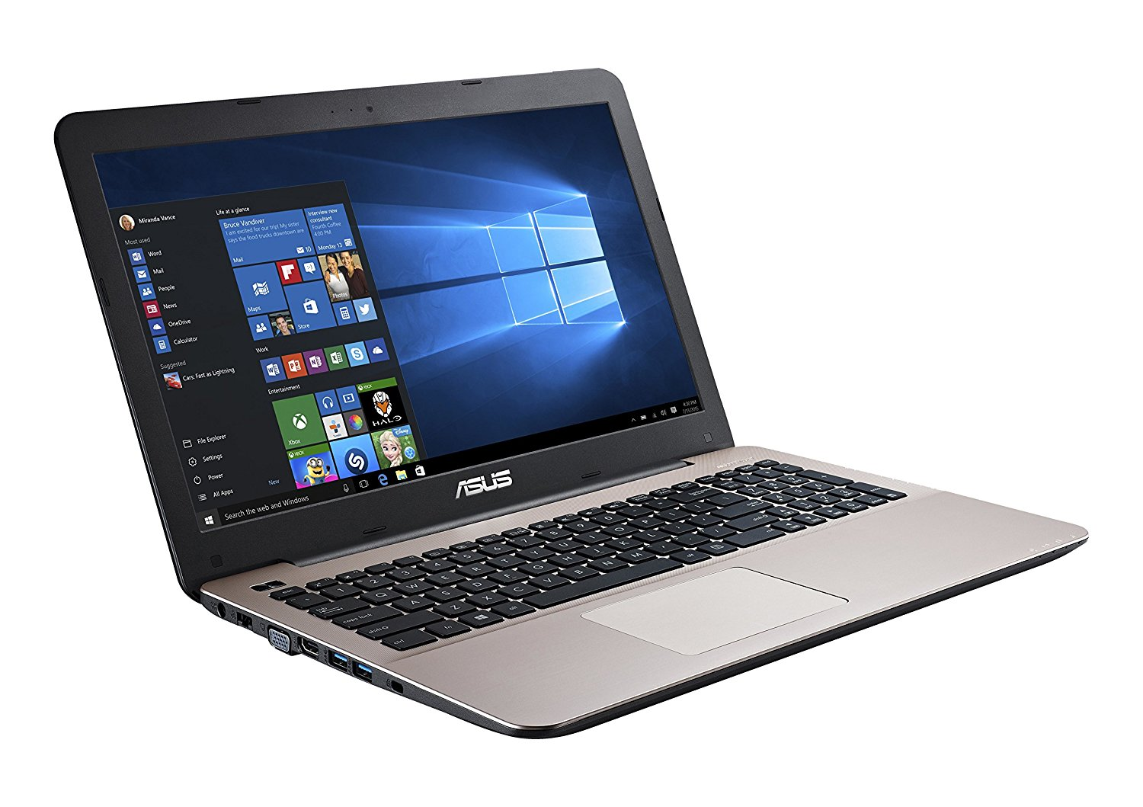
Example
Assume that our network admin Ben Owned is searching for a Christmas present for his boss. Wanting to make up for many of his past mistakes, Ben decides to browse his favorite online retailer to search for a new laptop.
This causes the web application to build an SQL query looking for any rows in the product table that include the word “laptop”.
SELECT * FROM product WHERE category = ‘laptop’;

Slide 5
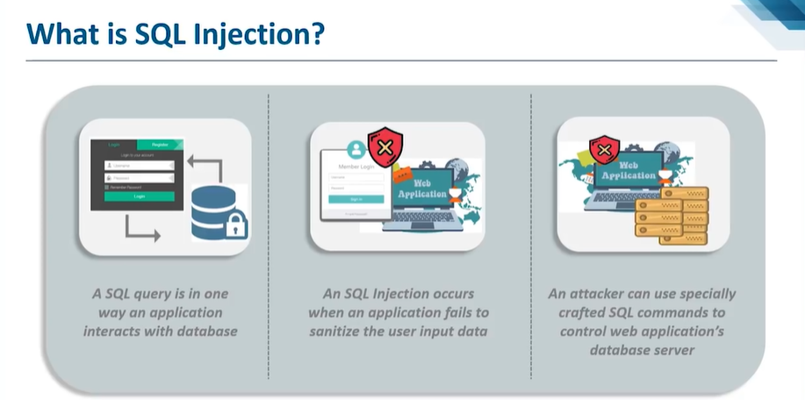

Slide 6
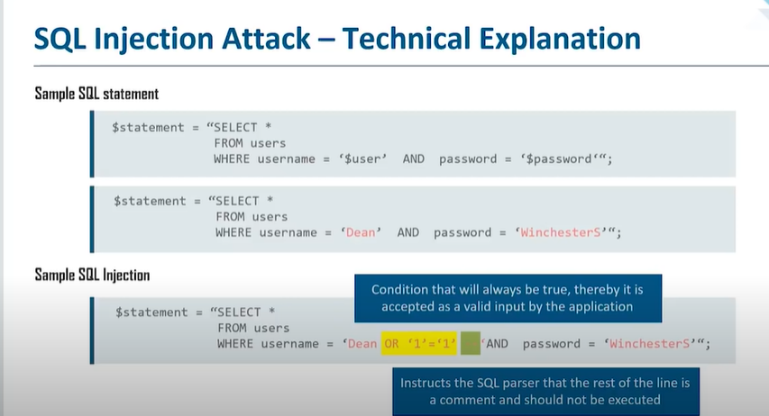

Slide 7
“SELECT” verb is used to tell SQL that you wish to search and return results from a table.
“*” is used as a wildcard and instructs SQL to return every column from the table when a match is found.
The “FROM” keyword is used to tell SQL which table to search
The “WHERE” clause is used to set up a test condition.

Slide 8
The application accepts whatever the user types into the “search” textbox and appends that string value to the end of the already created SQL statement
Last, a final single quote is appended onto the SQL statement to balance the quotes. It looks like this when it is all done
SELECT * FROM product WHERE category = ‘laptop’
Suppose we enter following into the search box
‘laptop’ or 1 = 1—
SELECT * FROM product WHERE category = ‘laptop’ or 1 = 1--’
The “--” is a programmatic comment. In most SQL versions, everything that follows the “--” is simply ignored by the interpreter. The final single quote is still appended by the application, but it is ignored.
It’s a trick for bypassing additional code that could interfere with your injection.
Here SQL will actually return all the records in the product table

Slide 9
Example 2:
In some instances, it is possible to simply enter a username followed by the “--” sequence. If interpreted correctly, this can cause the SQL statement to simply bypass or ignore the section of code that checks for a password and gives you access to the specified user
Example 3
SELECT * FROM users WHERE uname = “or 1 = 1-- and pwd = ‘syngress’”
You do need to supply a password to bypass client-side authentication (or you can use your intercepting proxy to delete this parameter altogether)

Slide 10
Example 4:
SELECT * FROM users WHERE uname = ‘admin’ and pwd = ‘’ or 1 = 1--

Slide 11
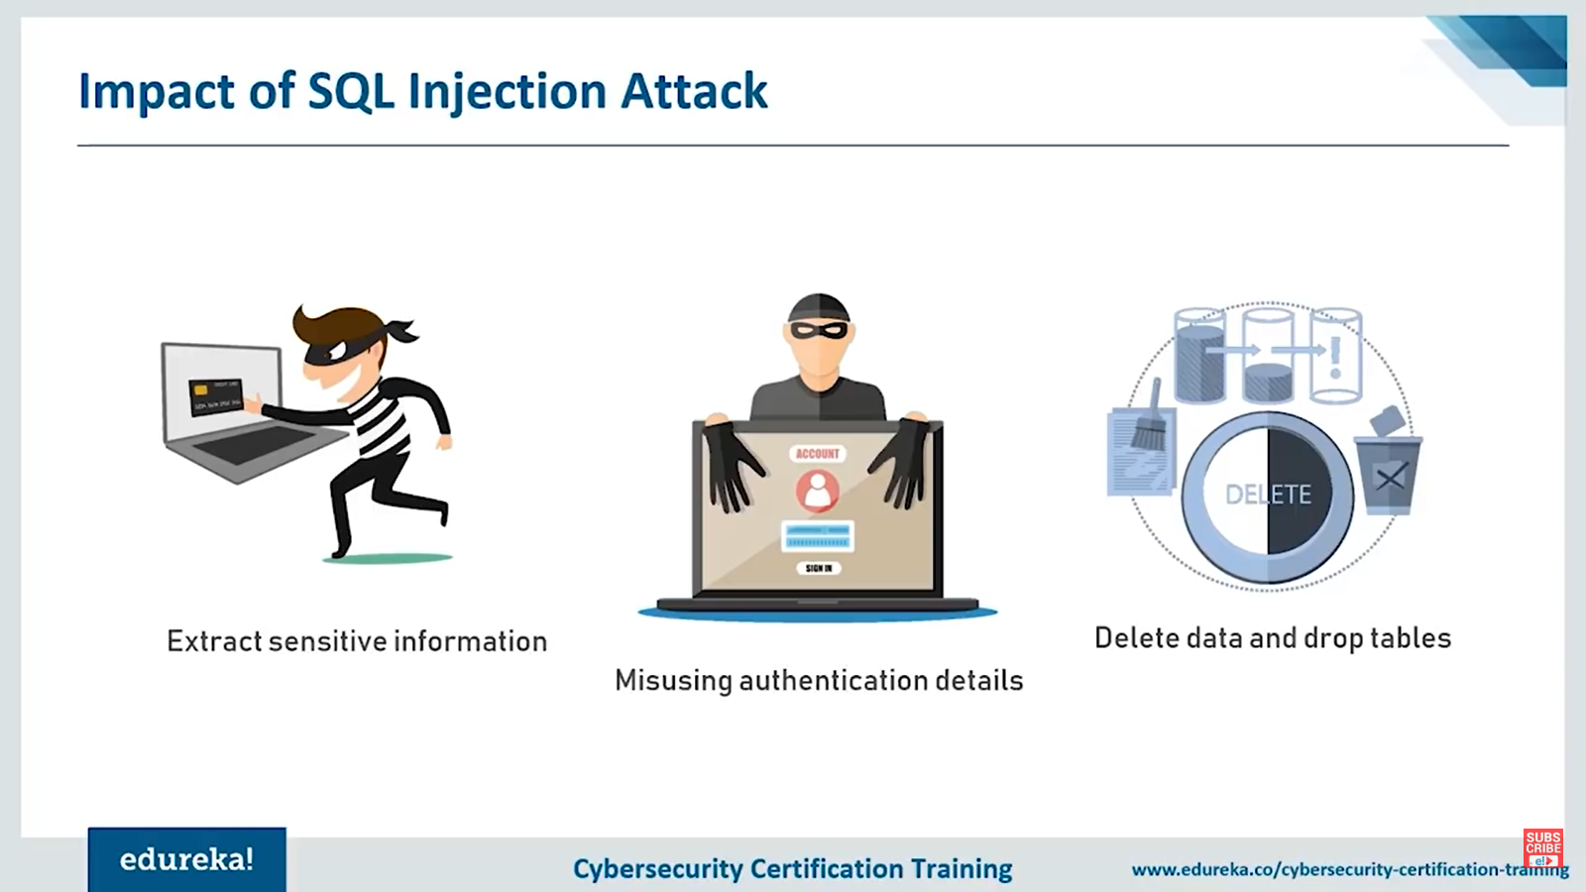

Slide 12
